Slide 1
COMP3017 Service Computing

Slide 2

Module Six: Service Engineering

Slide 3
Our materials for this module:
Thomas Erl, Service-Oriented Architecture, Concepts, Technology, and Design, ISBN：9787030336422，
Chapter 10
Chapter 11.1 and 11.2
Chapter 12.1
Chapter 13.1 and 13.5
Chapter 14.1
Chapter 15.1, 15.2, 15.3, and15.4
Chapter 16.3

Slide 4
Module 6 Learning Outcomes
Understand the common phases of an SOA delivery lifecycle
Understand the difference between different SOA delivery strategies
Be able to conduct a service-oriented analysis
Be able to use WSDL, SOAP and BPEL in service design

Slide 5
Guided questions for Module 6
What is a series of steps that need to be completed to construct the services for a given service-oriented solution?
What is a lifecycle of an SOA delivery project?
What are SOA delivery lifecycle phases?
What is the purpose of service-oriented analysis?
What happens in service-oriented design phase of an SOA delivery lifecycle?
What choices are made during service development?
What key issue face service testers?
What issues arise during service deployment?
What application management issues come to the forefront during service administration?

Slide 6
Guided questions for Module 6
What are three common SOA delivery strategies?
What is the process of top-down strategy?
What are the advantages and disadvantages of top-down strategy?
What is the process of bottom-up strategy?
What are the advantages and disadvantages of bottom-up strategy?
What is the process of agile strategy?
What are the advantages and disadvantages of agile strategy?
How do we use WSDL, SOAP and BPEL in service design?

Slide 7
SOA Lifecycle

Slide 8
Service Engineering
also called service-oriented software engineering
a software engineering process that attempts to decompose the system into self-running units that either perform services or expose services

Slide 9
SOA lifecycle
A series of steps that need to be completed to construct the services for a given service-oriented solution.
The basic SOA lifecycle consists of a series of phases similar to those used for regular development projects

Slide 10
SOA lifecycle
SOA introduces unique considerations in every phase of service construction and delivery

Slide 11
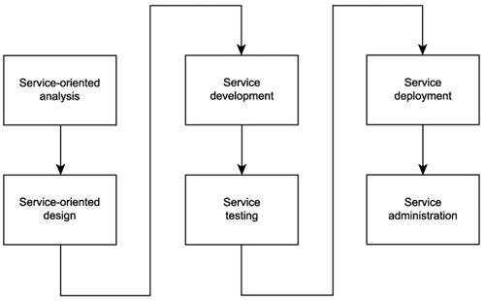
Common phases of an SOA delivery lifecycle

Slide 12
Service-oriented analysis
In this initial stage that we determine the potential scope of our SOA
Service layers are mapped out
Individual services are modeled as service candidates that comprise a preliminary SOA

